Slide 1


Doing Business With DDOT
DBE SUMMIT
September 29, 2017

Slide 2

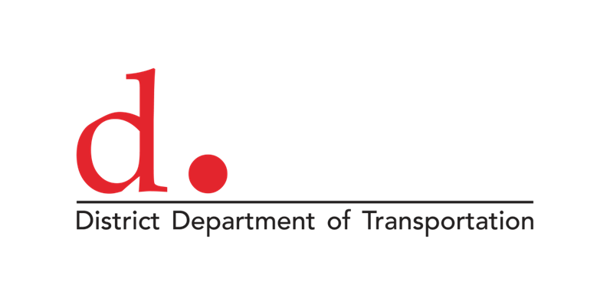
panel Agenda
      William Sharp, Chief Contracting Officer
      Sam Zimbabwe, Chief Project Delivery Officer
      Suzette Robinson, Chief Operations Officer
      José Colón, Chief Information Officer
      LaKisha Love, Operations Manager
      Davis-Bacon Division
      Q&A
      Lunch 12:35 PM
      Networking Session 2:00 PM

Slide 3


William E. “Bill” Sharp
Chief Contracting Officer
Office of Contracting and Procurement
District Department of Transportation

Slide 4
Overview of the Architect and Engineering (A/E) Schedule
DBE SUMMIT 2017
September 29, 2017

Slide 5

A/E by the Numbers
21 Categories of A/E Services
62 District Technical Evaluators across the 21 Panels
9 months of evaluations
148 firm submissions received
835 Statements of Qualifications (SOQs)
  Category D – Construction Engineering and Management Services received 76 SOQs
  Category A – Roadway Design received 68 SOQs
  Category R – Stormwater Management and Green Infrastructure received 60-76 SOQs
15,468 pages of material reviewed

Slide 6
The A/E Evaluation Process
Individual Evaluations
  Individual evaluations performed solely in accordance with the solicitation evaluation criteria.
    A/E Evaluation Criteria:
    Professional qualifications necessary for satisfactory performance of the
    required services;
    II. Specialized work in the required time;
    III. Past performance experience and technical competence in the type of work
    required;
    IV. Capacity to accomplish on contracts with the District, other governmental
    entities, and private industry in terms of cost control, quality of work, and
    compliance with performance schedule.
    b) Each evaluator documents the strengths and weaknesses for each offeror and
    c) Rates and scores each factor for each offeror.

Slide 7
Scoring Range
Purpose: Facilitate an efficient evaluation process
Established using the individual evaluator scoring
  Varied by category
Used to establish which firms proceed to consensus
  If a firm did not receive a score sufficient to be deemed qualified, they would not proceed through consensus
  (e.g., if your total average score was in the bottom 40% of the scoring in your category, there was no need for consensus)

Slide 8
Consensus
  Purpose: A Technical Panel meeting designed to flush out scoring variances and differences in opinions, and establish an agreed upon set of ratings and scores.
    The panel adjudicates all comments.
    Reaches consensus for each factor on every firm.
    Determines the final score and ranking of each firm.
  Source Selection Recommendation (SSR)
  Final outcome for the technical panel.
  Describes each individual panel’s discussions during consensus.
  Provides the final recommended ranking of all firms carried through consensus.

Slide 9
Source Selection Decision (SSD)
Performed by the Contracting Officer (CO)
Based upon the SSR (i.e., program’s recommendation)
Makes the comparative analysis, considers the District need, budget availability and past utilization of the A/E schedule (among others) in determining how many awards to make.
Successful Offeror letters are sent once the SSD is finalized by the CO.

Slide 10
Source Selection Decision (SSD)
The award process is being conducted in Phases. Phase one includes the following categories:
  Roadway design
  Streetscape and conceptual design
  Bridge design
  Geotechnical Investigation and Studies
  Environmental Engineering Investigation and Studies
  Public participation and partnering
  Right of way services
  Intelligent transportation studies
As the determinations on Category are performed by the Contracting Officer (CO), firms are notified.
At this point, we have notified most but not all of the firms included in the above categories.
Successful Offeror letters are sent once the SSD is finalized by the CO.

Slide 11
Task Order Process - NEW
Project Manager develops the requirements document (SOW, PWS), Independent Government Estimate (IGE), and identifies the funding source;
Project Manager submits a TO request in ProTrack+
ProTrack+ has steps and checks built in to facilitate fair opportunity
  All firms will be given a chance to compete for an opportunity
Firms selected to participate will be sent a Request for Qualifications
Qualifications will be evaluated and the Most Highly Qualified firm determined;
RFTOP sent to Most Highly Qualified firm
Level of effort and price negotiated using IDIQ DSE
TO Award

Slide 12
Publicizing Task Order Requirements
  All A/E competitions will be publicized in DTAP and on OCP’s solicitation site.
  The publications will include:
    Prime contractors solicited
    Requirements Document (SOW, PWS)
    Other pertinent details
  NEW ITEM ALERT – SubContracting Clause
  Details and DTAP Portal still being developed
  DTAP will have a SubContracting Portal to facilitate communication among primes and subs
  Primes must respond to sub inquiries within 3 business days; a prime may respond “no bid” and another firm may be added

Slide 13
A/E Schedule – A Look Ahead
NOTE: All offerors will receive a notification (either award or debriefing
package) regarding the categories they submitted to.
Phase I
The District is still preparing documents for Phase I awards.
  It is anticipated that Phase I awards should be finalized next week.
At this time, we cannot answer specific status questions.
Phase II
We will begin preparing Phase II documents the 2nd week in October
We will send out Phase II Successful Offeror letters mid October

Slide 14
A/E Schedule – A Look Ahead (continued)
Debriefing packages
Only one debriefing letter will be sent per firm.
It will contain the strengths and weaknesses of each of your category submissions.
Request for Task Order Proposal (RFTOP) Timing
Will commence as soon as all awards are made for a given category.
For some categories in Phase I, could be as early as 2nd week in October.

Slide 15
Resources
The District has prepared a number of resources in helping firms understand how we do business. A few of these include:
A/E Services Schedule – Frequently Asked Questions
Good to Great – Discusses considerations in improving your evaluation ratings.
A copy of these documents will be available at our booth, and on OCP’s website soon.
Please come see us at our table during the Networking Session this afternoon for additional questions.

Slide 16
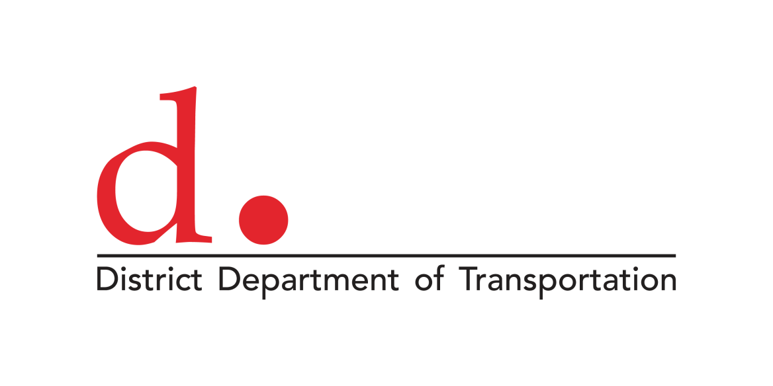

  Sam Zimbabwe
  Chief Project Delivery Officer
  District Department of Transportation

Slide 17
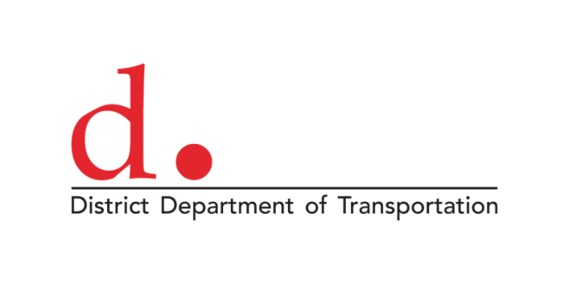
Project Delivery Administration
  Aligns four divisions:
    Planning & Sustainability
    Traffic Engineering & Signals
    Transit Delivery
    Infrastructure Project Management (Design & Construction)
  Goal of accelerating timelines for project development and improving quality of projects

Slide 18
Support & Opportunities
  Professional services
    Area planning studies, corridor planning studies, environmental review, engineering design
    Growing focus on advanced transit/pedestrian/bicycle design and green infrastructure
  Primarily a mix of local operating funds (CBE requirements) and Federal capital funds (DBE goals)

Slide 19
Support & Opportunities
  Construction and Construction Management
    Small and large projects
    New emphasis on small-scale construction for safety improvements and bicycle and pedestrian implementation.
  Mix of local capital funds (CBE requirements) and Federal capital funds (DBE goals)

Slide 20
Current and upcoming major opportunities
Design: Benning Streetcar Extension – RFQ open through November 14, 2017
Transit: DC Circulator Operations and Maintenance – RFP open through November 16, 2017 (Industry Day October 12, 2017)
Traffic Engineering: Upcoming Safety Construction IFB for IDIQ small-scale safety upgrades
Construction Project Forecast: http://projects.ddotsites.com/

Slide 21
Project Delivery Key Contacts
    Me: sam.zimbabwe@dc.gov
  Planning & Sustainability
    Jim Sebastian, Associate Director: jim.sebastian@dc.gov
  Traffic Engineering & Signals
    Wasim Raja, Associate Director: wasim.raja@dc.gov
  Transit Delivery
    Cleve Cleveland, Associate Director: cleve.cleveland@dc.gov
  Infrastructure Project Management (Design & Construction)
    Dawit Muluneh, Chief Engineer: dawit.muluneh@dc.gov
    Rick Kenney, Deputy Chief Engineer (Ward Teams): richard.kenney@dc.gov
    Ravi Ganvir, Deputy Chief Engineer (AWI): ravindra.ganvir@dc.gov

Slide 22
  Suzette Robinson
  Chief Operations Officer
  District Department of Transportation

Slide 23
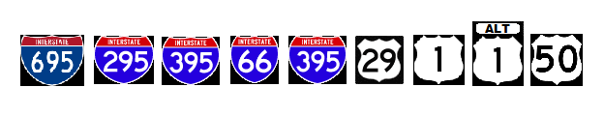
FUNDING
Interstate and U.S. Routes: Federal Funding
DBE Goals apply
District Streets and Alleys: DC Funding
CBE Goals apply

Slide 24
Operations Administration
  Maintenance Operations Division
  Urban Forestry Division
  Traffic Operations and Safety Division
  Parking and Ground Transportation

Slide 25
Operations Administration
Lockers
Personal Protection Equipment
Public Information Support
Maintenance Planning Support
Safety Boots

Slide 26
Maintenance Division
Street and Bridge Maintenance Branch
Construction materials (concrete, gravel, bricks, sand, cold patch
Traffic supplies (cones, barricades, barrels)
Equipment Rental
Miscellaneous Tools
Traffic Signals and Streetlight Maintenance Branch
CCTV Cameras
Detector system replacement
Battery Replacement for UPS system
Pole Painting
LED Streetlight conversion

Slide 27
Asset Management Branch
Ward-Based Concrete and Brick sidewalk repair
Consulting service for Inspection and Contract Management
Sewer Cleaning Contract
Flexi-pave Design to Construction
On-Call Design services
Local Paving
Federal Paving

Slide 28
Traffic Operations and Safety Division
Safety Branch
Traffic Safety and Engineering consulting services
Traffic Studies
Traffic Operation Branch
ROP and TMC Supplies
Field Operations Branch
Pavement Marking
Sign Fabrication Supplies and Materials
Specialty Sign Fabrication
ITS Branch
Fiber Optic Construction

Slide 29
Parking and Ground Transportation
Asset Management for Parking Meter Assets
Public Outreach and Communications for Curbside Management
Park Mobile – Pay-by-Phone for parking services

Slide 30
Urban Forestry Division
Emergency and Routine Tree Removal
Landscaping/Green Infrastructure Maintenance
Urban Forestry Specialty Materials
Plant Healthcare Services

Slide 31
  José Colón, Jr.
  Chief Information Officer
District Department of Transportation

Slide 32


DTAP
District Transportation Access Portal
Online dashboard access to real-time information about ongoing projects in the study, design, procurement and/or construction process.
Public projects and private development applications under DDOT review
A resource that utility companies can use to coordinate capital improvement projects, reduce conflicts, and protect newly paved streets from excessive utility work

Slide 33
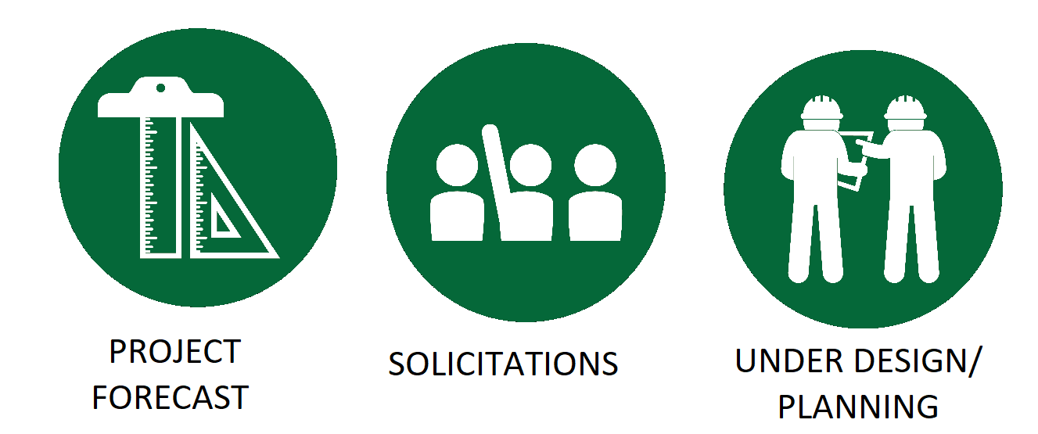
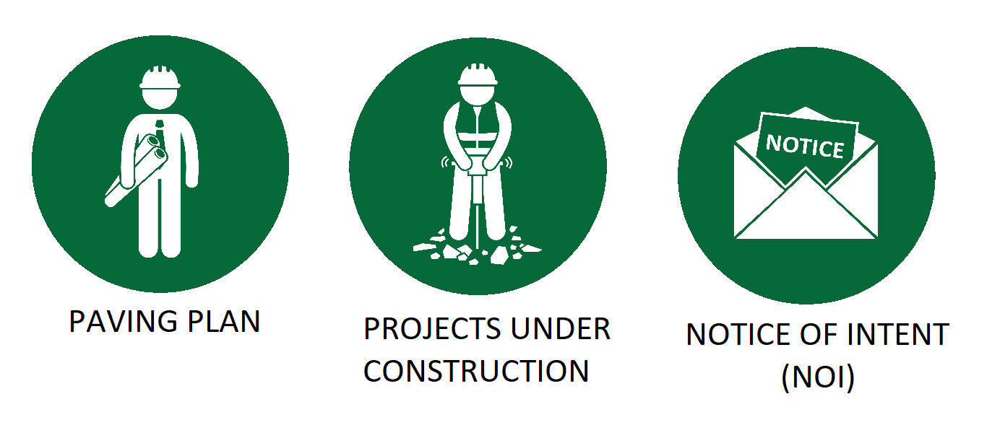
DDOT Project Pipeline

Slide 34

DDOT Connects
DDOT API: Circulator Bus data (real-time positions, history, bus stops, etc.), carshare and bikeshare information
Signal Phasing Data Service: Approved user access to DDOT's traffic signal phasing data to utilize in applications to improve transportation efficiency
DC Data Services: DC GIS provides District agencies and the public geospatial data and enterprise applications
Transit IQ: Track your vehicles with Android mobile devices (smartphones or tablets)
District of Columbia Open Data: Search for data sets by topic, explore featured data sets or review the full list of DC data sets

Slide 35

ProTrack Plus
  Urban Project Management Information System
  Centralizes project-related data transactions
  Global perspective of project and program management
  GIS centric
  Captures the geographic extent of all DDOT infrastructure projects
  Displays relationships between a given project and its location, and any related or potential conflicts and/or cost sharing opportunities

Slide 36
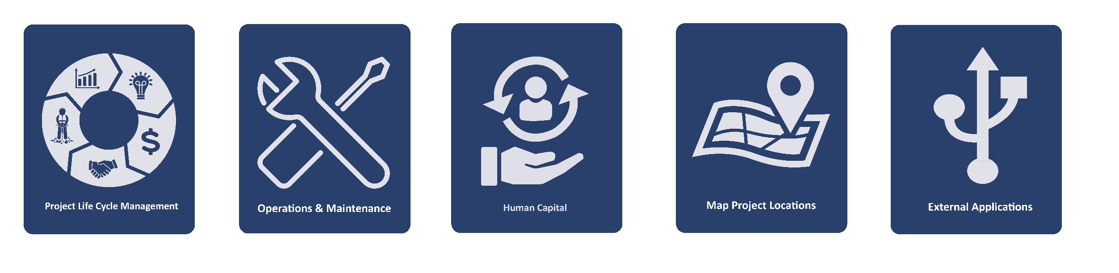
ProTrack Plus
  Central point for project-related documentation management, process authorization, and decision making workflows.
  One-Stop-Shop solution
  Allows project-related stakeholders to collaborate on projects
  Eliminates redundant data entry
  Reduces communication gaps
  Provides a visual component for project locations

Slide 37

Online Certification
  Online Small Business Certification

Slide 38
  LaKisha Love
  Operations Manager
Office of the Chief Administrative Officer
Davis-Bacon Compliance Division

Slide 39
The Davis-Bacon Act
  Enacted in 1931
  Code of Federal Regulations 29 CFR Parts 1 - 8 apply to contractors and subcontractors
      Purpose – To protect communities and workers from the economic disruption caused by non-local contractors under-bidding local wage levels
  Payment of local “prevailing wages” and “fringe benefits” to laborers and mechanics, as determined by the U.S. Department of Labor (DOL)

Slide 40
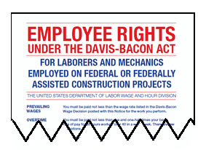
Davis-Bacon Requirements
  Applies to Federal and District of Columbia construction contracts in excess of $2,000
  Applies only to employment being performed on the “site of work”
  Laborers & mechanics must be paid weekly
  Wage determination and the Davis-Bacon Poster (WH-1321) must be posted at the site of work

Slide 41
Davis-Bacon Enforcement
  100% review of “certified payrolls”
  Conduct Site Visits & Labor Standard Interviews
  Ensure compliance of Contract Work Hours and Safety Standards Act (CWHSSA) – Overtime
  Compliance with Copeland “Anti-Kickback” Act –
    Prohibits “kickback” of wages
    Requires contractors to submit weekly “statement of compliance”
  Contractor Payment Withholdings
  Investigations and/or Debarment

Slide 42

Labor Compliance Tracker
A paperless, online system for entering Certified Payrolls:
  Confirms rates and classifications prior to allowing contractors to submit payrolls (with DOES approvals of Apprenticeship/Trainees) to their Administrator and to the DDOT Davis-Bacon Compliance Division
  Provides instant contractors reports in hard copy and electronic formats that are stored in the online database
  Eliminates the need to submit paper documents as payrolls will be submitted electronically
  No cost to contractors for this service, training or support

Slide 43

DBE SUMMIT
September 29, 2017

