Slide 1
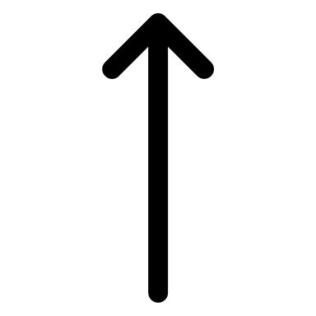
BLOCK PARTY TRAFFIC CONTROL PLAN
Tracking Number: ____________________
Block Party Location: ____________________
CONDITIONS
Use 28” high MUTCD standard cones.
Provide two ROAD CLOSED (R11-2) 48”x30” signs with white background and black color letters. The size of the letters must be a min. of 4” and upper case. Signs can be handmade.
Provide and maintain a 20’ wide fire lane at all times.
Street B
Street A
ROAD CLOSED
ROAD CLOSED
Street D
20’ FIRE LANE
Street E
Legend
Street C
N
28" Cones
Personal Vehicle

